Slide 1
CHAPTER-1 .net and its Framework
Pushpinder kaur
Subject matter expert

Slide 2
.net
.net is a platform using which we can develop, deploy, host, maintain and execute an application.
It means .net caters with entire development lifecycle of an application.
Notes:
Explain SDLC and Agile model.

Slide 3
Components of .net Framework
1).net Compliant languages
2)Common Language specification(CLS)
3)Framework Class Library(FCL)
4)Common Language Runtime(CLR)

Slide 4
Architecture
VB
C++
C#
JScript
J#......
Visual Studio.IDE
Common Language Specification
ASP.NET
Web Forms Web Services
Mobile Internet Toolkit
Windows
Forms
ADO.NET and XML
Framework Class Library
Common Language Runtime

Slide 5
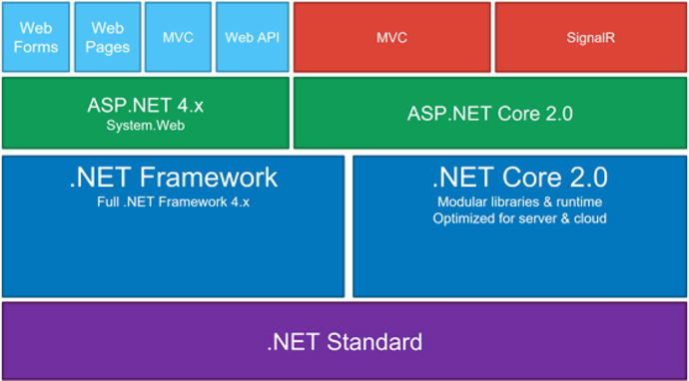
.Net Core Architecture

Slide 6
1) .net compliant language
These are the languages which are compatible with .net framework.
Latest version of .net framework i.e. .net 4.6 supports 30+ languages. All languages are standardized by ECMA.

Slide 7
VB
C++
C#
JScript
J#......
Common Language Specification

Slide 8
2) Common Language Specification (CLS)
Some specified set of rules and regulations.
Body governing these rules is ECMA(European Computer Manufactures Association)

Slide 9
Common Type System(CTS)
CTS(Common Type System ) a sub-component of CLS
It allows language interoperability and type safety.
Defines rules regarding data types and all these types are derived from a base class System.Object

Slide 10
3) Framework Class Library(FCL)
Collection of classes
Helps to collect logically related classes in a common namespace. Resolves name conflict.
contains classes that can be used to build application like windows forms, web application, WPF, WCF etc.
Contains a sub-component named BCL

Slide 11
VB
C++
C#
JScript
J#......
Common Language Specification
ASP.NET
Web Forms Web Services
Mobile Internet Toolkit
Windows
Forms
ADO.NET and XML
Framework Class Library

Slide 12
Base Class Library (BCL)
A sub-component Framework Class Library(FCL)
provides common classes that can be used commonly in all types of application. Eg: System.io, System.Text etc.

Slide 13
VB
C++
C#
JScript
J#......
Common Language Specification
ASP.NET
Web Forms Web Services
Mobile Internet Toolkit
Windows
Forms
ADO.NET and XML
Framework Class Library
Common Language Runtime

Slide 14
4) Common Language Runtime(CLR)
The main execution engine responsible for managing execution of an application.
Notes:
Garbage Collection :- CLR automatically manages memory thus eliminating memory leaks. When objects are not referred GC automatically releases those memory thus providing efficient memory management. Code Access Security :- CAS grants rights to program depending on the security configuration of the machine. Example the program has rights to edit or create a new file but the security configuration of machine does not allow the program to delete a file. CAS will take care that the code runs under the environment of machines security configuration. Code Verification :- This ensures proper code execution and type safety while the code runs. It prevents the source code to perform illegal operation such as accessing invalid memory locations etc. IL( Intermediate language )-to-native translators and optimizer's :- CLR uses JIT and compiles the IL code to machine code and then executes. CLR also determines depending on platform what is optimized way of running the IL code.

Slide 15
Services done by CLR:
1. Secure execution of code : checks code if the is not breaching any network policy.
2. Exception handling : .net provides common exception handling for all compliant languages.
3. Memory management : garbage collection.
Notes:
4. IL( Intermediate language )-to-native translators and optimizer's :- CLR uses JIT and compiles the IL code to machine code and then executes. CLR also determines depending on platform what is optimized way of running the IL code.

Slide 16
More on Services
Garbage Collection :- CLR automatically manages memory thus eliminating memory leaks. When objects are not referred GC automatically releases those memory thus providing efficient memory management.
Code Access Security :- CAS grants rights to program depending on the security configuration of the machine. Example the program has rights to edit or create a new file but the security configuration of machine does not allow the program to delete a file. CAS will take care that the code runs under the environment of machines security configuration.
Code Verification :- This ensures proper code execution and type safety while the code runs. It prevents the source code to perform illegal operation such as accessing invalid memory locations etc.
Notes:
You may view CLR in c:\Windows\assembly\mscorlib
Recent version of CLR with 4.5 is 4.0 and 5.0 for C#
CLR is a runtime environment, the heart of the CLR is typically thought of as mscoree.dll, which will live in the system32 directory.
We can locate C:\Windows\Microsoft.NET\Framework\v2.0.50727\clr.dll
Primary one is mscorlib.dll

Slide 17
VB
C++
C#
JScript
J#......
Visual Studio.IDE
Common Language Specification
ASP.NET
Web Forms Web Services
Mobile Internet Toolkit
Windows
Forms
ADO.NET and XML
Framework Class Library
Common Language Runtime

Slide 18
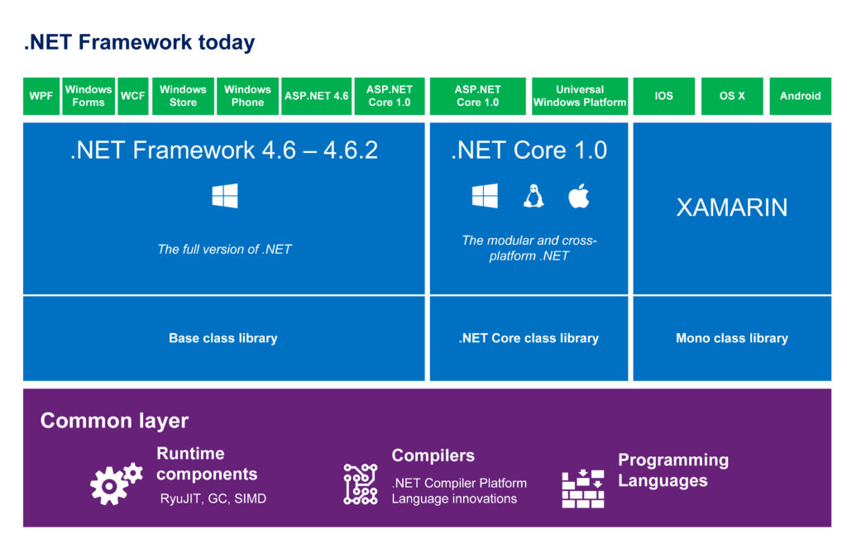

Slide 19
Visual studio IDE
Visual Studio provides the tools/environment you need to design, develop, debug, and deploy Web applications, XML Web Services, and traditional client applications.

Slide 20
Interaction
.NET Application
.NET Framework
Operating System + Hardware

Slide 21
Compilation in .NET
Code in VB.NET
Code in C#
Code in another
.NET Language
VB.NET compiler
C# compiler
Appropriate
Compiler
IL(Intermediate
Language) code
CLR just-in-time
execution

Slide 22
MSIL(Microsoft Intermediate Language)
MSIL is a CPU-independent set of instructions that can be efficiently converted to native code(machine code).
MSIL includes instructions for loading, storing, initializing, and calling methods on objects, as well as instructions for arithmetic and logical operations, control flow, direct memory access, exception handling, and other operations.
Before code can be run, MSIL must be converted to CPU-specific code, usually by a just-in-time (JIT) compiler.

Slide 23
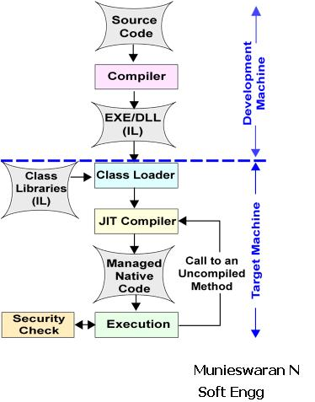
Execution in .net

